Slide 1




ROLE OF EDUCATIONAL ACTIVITIES (E.G,E-LEARNING) IN PROMOTING DISASTER RISK REDUCTION (DRR) & CLIMATE CHANGE ADAPTATION (CCA)
Grand Sahid Jaya Hotel Jakarta, Indonesia
February 19-22, 2014
Organized by:
Supported by:

Slide 2
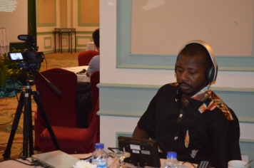
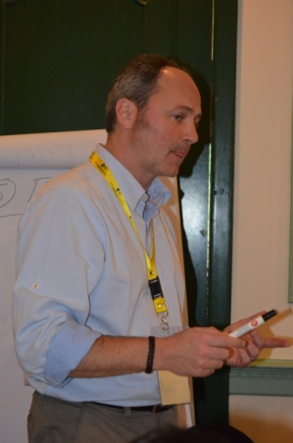
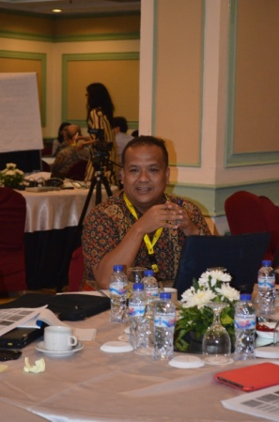
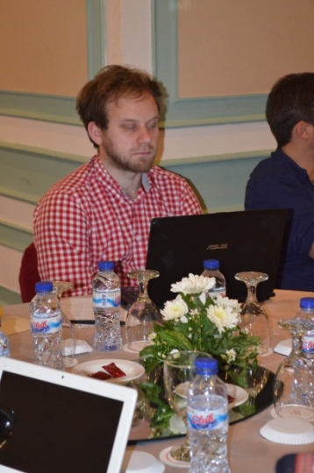
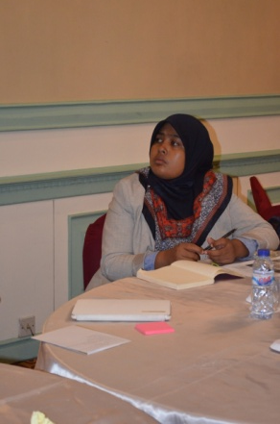
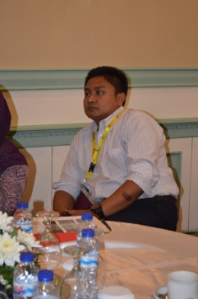
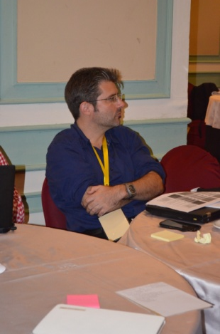
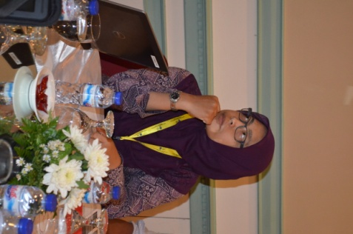
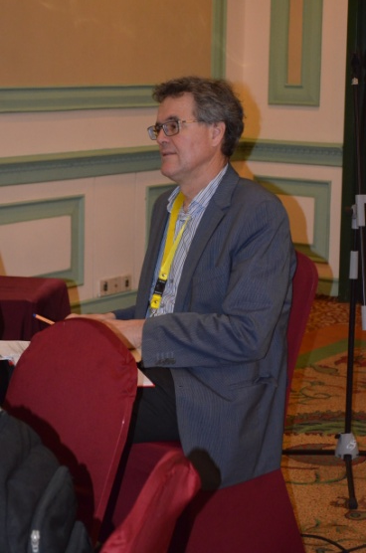
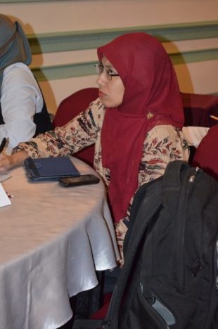
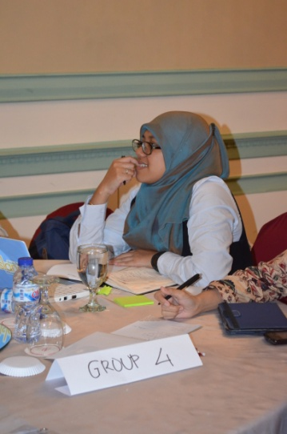
GROUP MODERATOR
RAPPORTEUR
Erick Tambo (UNU)
Joerg Szarzynki (UNU-EHS)
R. Fajar Lubis (LIPI)
Syarifah Dalimunte (LIPI)
Gabriel David (FI UNI Hannover)
Faizal Rachman (UGM)
Carsten Thoms (DAAD)
Riasasi Widiyana (UGM)
Velly A (BPPT)
Jakob Rhyner (UNU-EHS)
Rae Sita (LIPI)

Slide 3
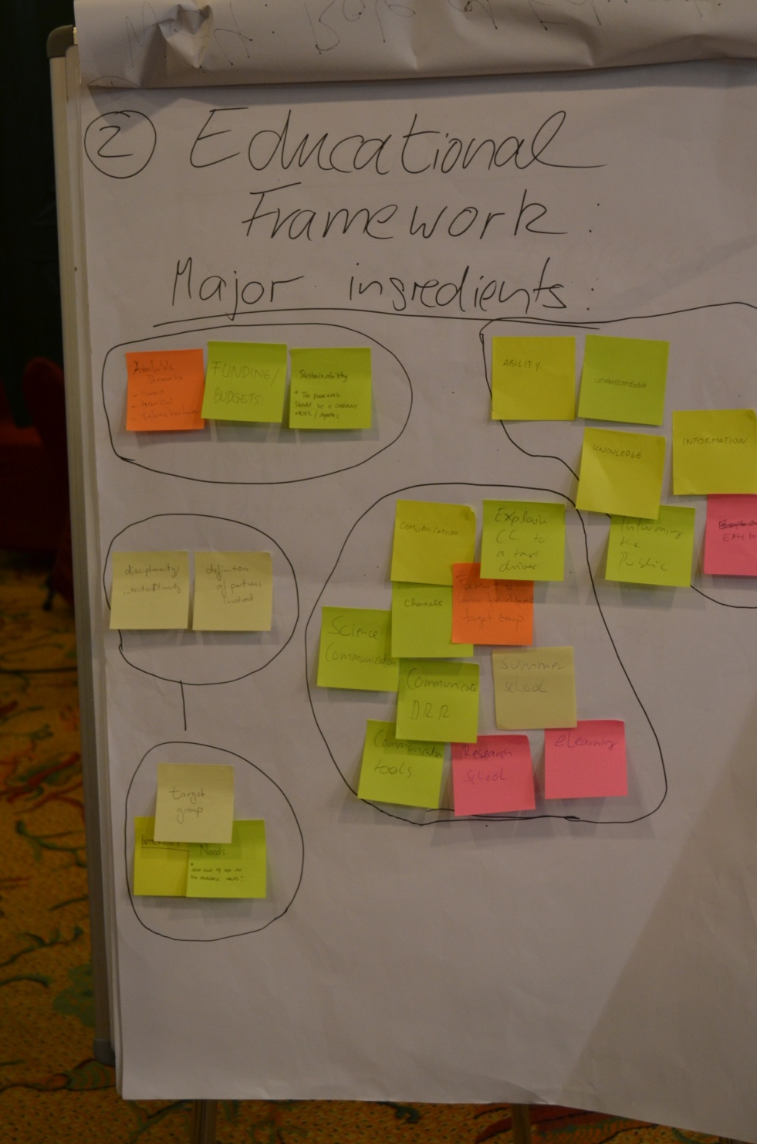
Brainstorm: Major Ingredients for an educational framework.
• Resources
• Information / Knowledge / Knowledge Transfer
• Interdisciplinary Group (transmiting)
• Target Group (receiving)
• Communication Tools

Slide 4
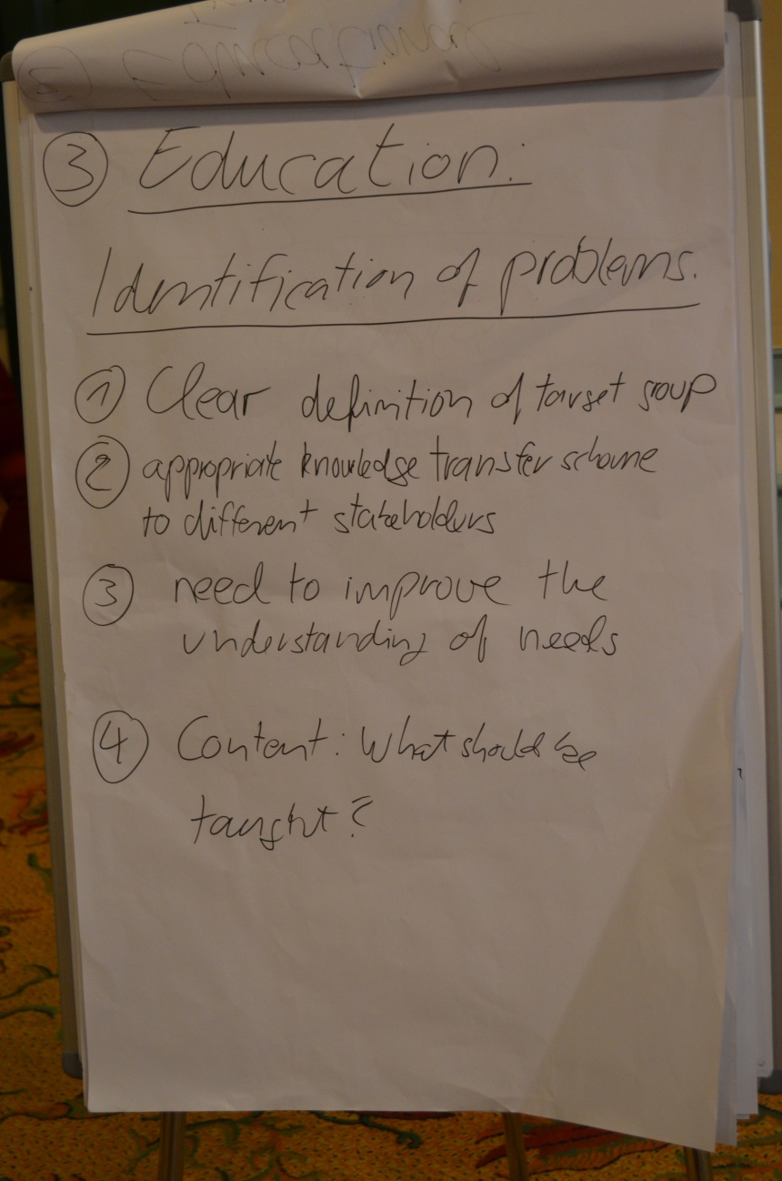
Classification of problems:
Clear definition of target group
Appropriate knowledge transfer scheme to different stakeholders. (Communication)
Need to improve the understanding of need.
Content: What should be taught?

Slide 5
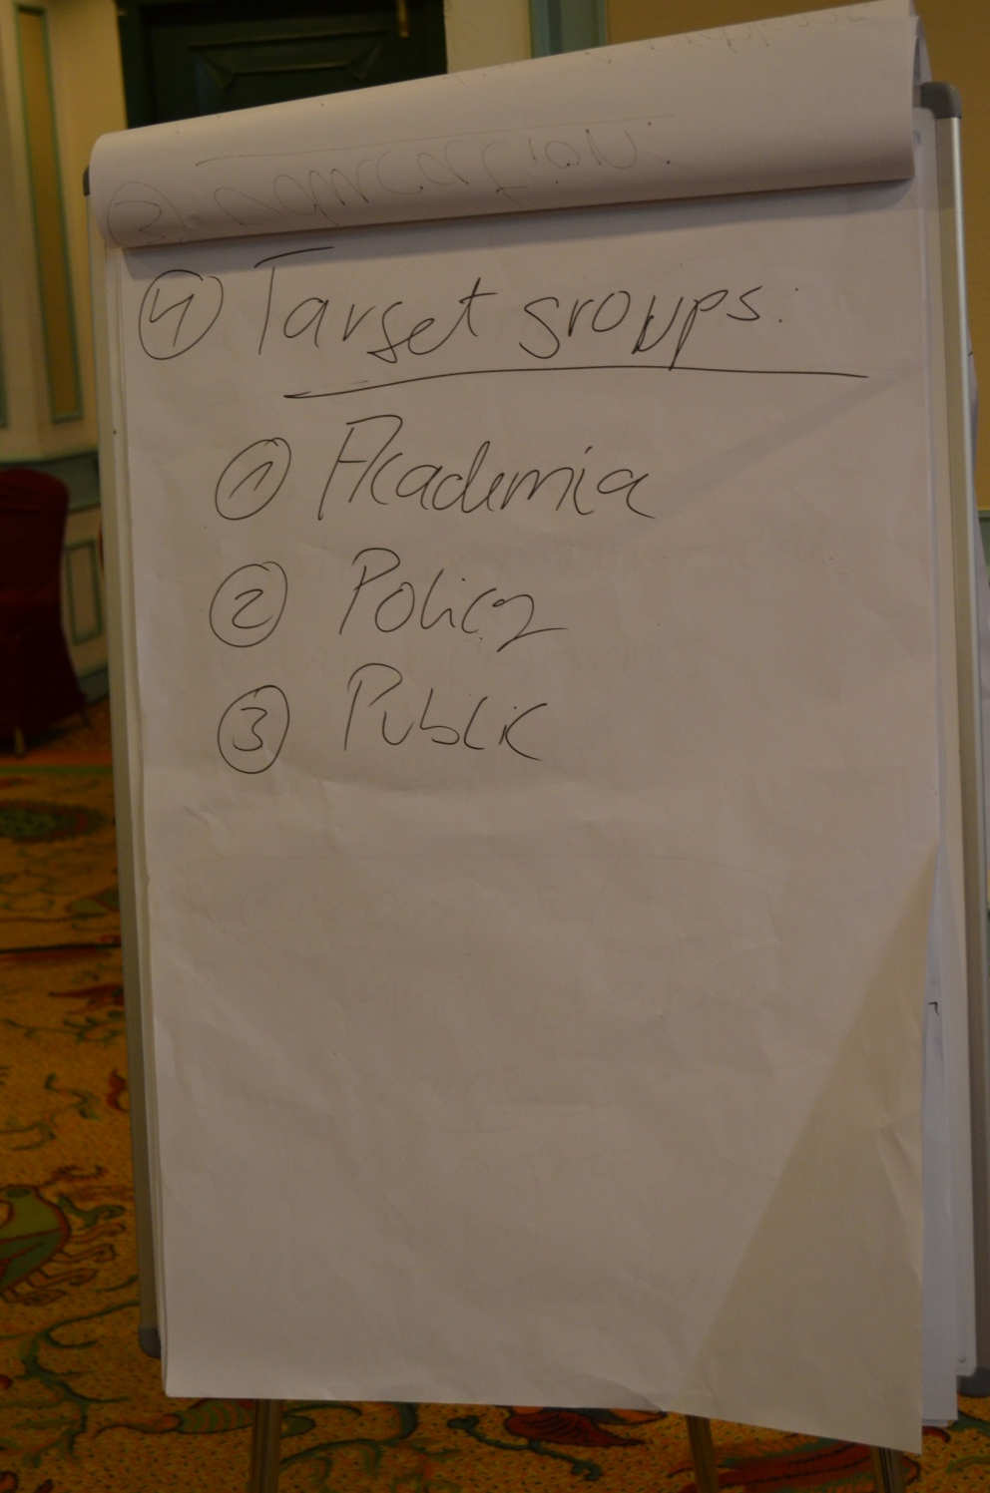
Target groups:
Academia
Policy Maker
Public

Slide 6
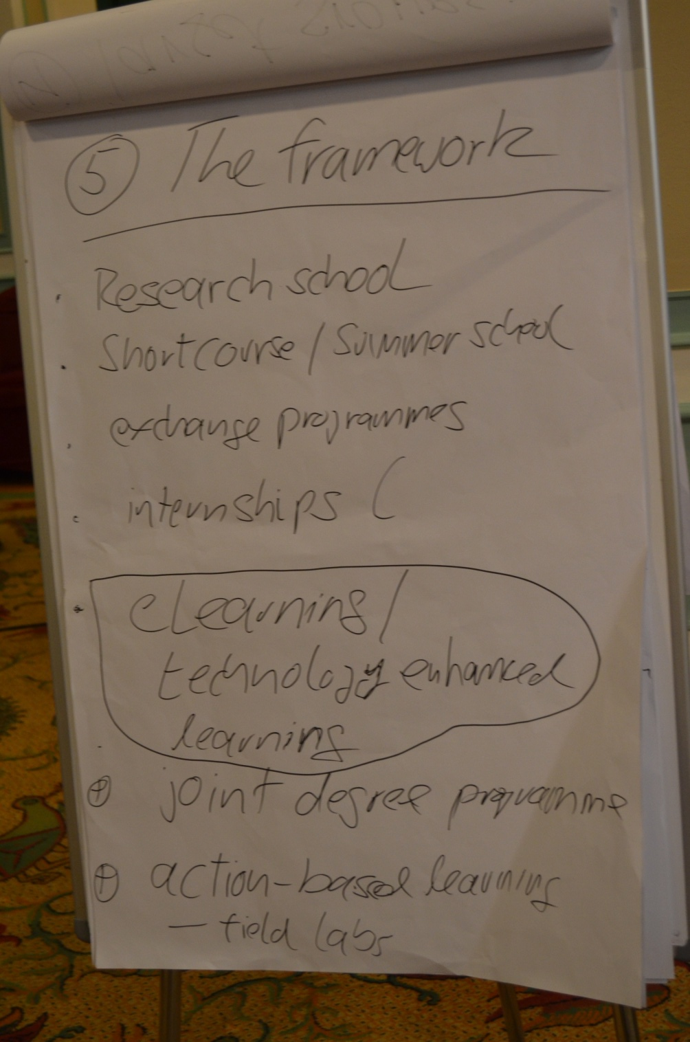
“open” framework, which can be adapted for every expert to contribute
Framework elements:
1. research school
2. short courses / summer school
3. exchange programs
4. (international) internship
5. e-learning/technology-enhanced learning
6. joint degree program
7. Action based learning, field lab experience

Slide 7
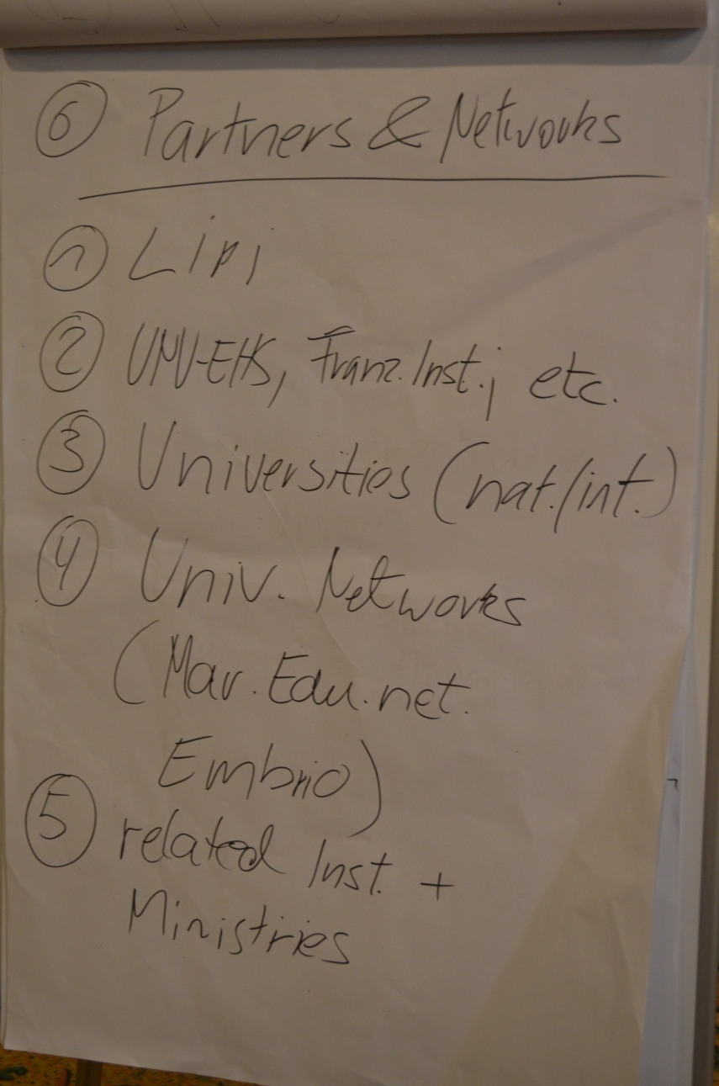
Partners:
1. LIPI
2. UNU, Franzius Institute, etc
-------------------------------------
3. university networks
• marine education network (maredunet, embrio)
• (…)
4. national and international universities
5. related institutes and ministries (UNIDO, BPPT, DKP, etc)

Slide 8
E-Learning:
1. resources
2. platform
3. internet connections
4. technical devices
5. human ressources
6. financial ressources
7. training capacities
8. formats:
a. e-lectures
b. webinars
c. offline database (CD, USB-Stick, etc.)
d. podcasts, community radio and TV shows
mobile learning
Finally: Quality assurance (ECB-Check etc.)

Slide 9
WORK PLAN
GETTING STARTED
TIME FRAME: 2-4 YEARS
INPUT FROM WG 1+2 plus further extensions
LIPI: DEFINITION OF MAJOR GOALS AND MILESTONES
ESTABLISHMENT OF A JOINT ACADEMIC BOARD
RESOURCE ALLOCATION AND FUNDING OPTIONS
CURRICULUM DEVELOPMENT or PROGRAM DESCRIPTION
STRUCTURAL ELEMENTS:
E-LEARNING (E LECTURES, WEBINARS etc.)
SHORT COURSE
RESEARCH SCHOOL (Joint Master or PhD Program)

Slide 10
Structural establishment
Getting the educational program started
LIPI: Definition of Major Goals & Aims
Input WS1+2
1. recording 1st documentation / e-resources
Workshop outcome
2. populate existing form in Bonn
3. identification of appropriate e-lerning materials
Deriving templates
Steering Board
Responsibilities / Parties involved
Definition of the overarching scientific concept
Definitions for education program:
Scientific Context
Timeline
4. establishing the 1st courses / curriculum based on the steering board decision
Program development mission
lecture capturing
curriculum
5. Local setup of platform management in Jakarta

Slide 11
TIMELINE
 | 21 FEB | March | April | May | June | July | Aug | Sept | Oct | Nov | Dec
Working Group Input | V
Decision major goals by LIPI | V
Decision on a “Joint steering commitee” or “Joint academic Board | V
Definition of a step
E-learning
Short Course
Research school

Slide 12
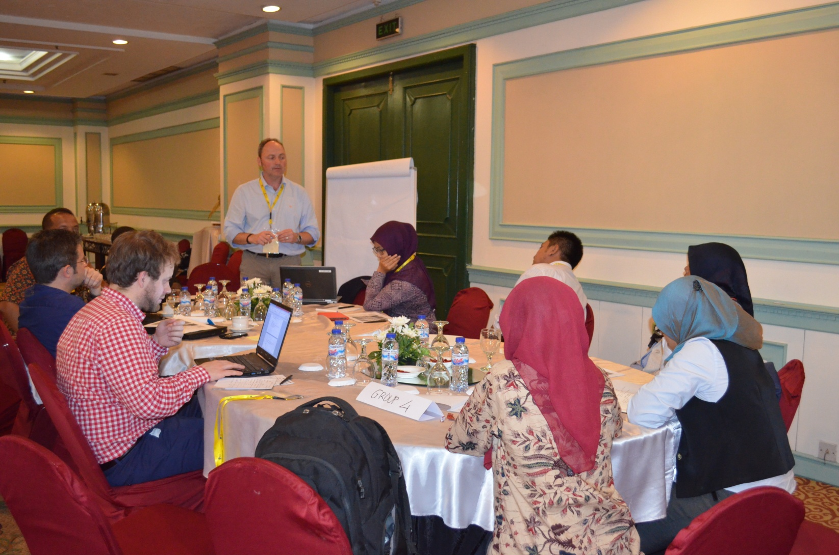
THANK YOU

